Slide 1
MedTrack
Healthcare Data Analytics Project
Hospital operations • Readmission analysis • Resource utilization
Final Project Presentation
Presented by: Gandipalli Kavya

Slide 2
1. Project Overview
Purpose and scope
Project goal
Data quality
Patient flow
Turn hospital data into clear insights that support operational monitoring and resource planning.
Profile data and check missing values, duplicates, and data types.
Review admissions, discharges, and readmission patterns.
Resources
Dashboards
Workflow: Data → Cleaning → Analysis → KPIs → Dashboard → Reporting
Analyze bed utilization and department indicators.
Communicate findings through Tableau visuals.
MedTrack | Healthcare Data Analytics Project
2

Slide 3
2. Tools and Workflow
End-to-end analytics process
• Collect healthcare CSV datasets.
• Profile rows, columns, and data types.
• Clean and standardize dates and categories.
• Analyze readmission and resource indicators.
• Visualize key findings in Tableau.
• Store milestone deliverables in GitHub.
Tools
Deliverables
Python • pandas • Excel/CSV • Tableau • GitHub
Scripts • Reports • KPI sheets • Dashboard
MedTrack | Healthcare Data Analytics Project
3

Slide 4
3. Milestone Summary
Work completed across the project
Milestone 1 — Dataset profiling and cleaning
Inspected dataset structure, reviewed missing values and duplicates, and standardized date fields.
Milestone 2 — Resource KPIs
Prepared Bed Utilization Rate and Department Efficiency Score analysis with supporting summary sheets.
Milestone 3 — Tableau dashboard
Created dashboard views to communicate resource utilization and department-level comparisons.
Milestone 4 — Data testing reports
Prepared a Python testing script, testing summary CSV, and missing-details CSV.
MedTrack | Healthcare Data Analytics Project
4

Slide 5
4. Dataset Profiling and Cleaning
Readmission dataset
Dataset size
Duplicate check
Date fields
10,000 rows
26 columns
0 duplicate rows reported after cleaning
Admission, check-in, and check-out converted to datetime
Fields reviewed
Quality checks
• Admission and discharge dates
• Patient age and length of stay
• Waiting time and bed availability
• Ward, discharge status, and readmission
• Missing-value review
• Duplicate-row check
• Data-type standardization
• Category consistency review
MedTrack | Healthcare Data Analytics Project
5

Slide 6
5. Readmission Dataset Snapshot
Descriptive counts from the profiled dataset
Readmission = 1
Readmission = 0
Total
4,142 records
5,858 records
10,000 records
Other observed distributions
• Gender: 5,012 male and 4,988 female records.
• Ward categories included Pediatrics, Emergency Department, ICU, Maternity, and Surgery.
• Discharge categories included Recovered, Deceased, and Transferred.
These are descriptive counts; they do not establish causes or clinical risk.
MedTrack | Healthcare Data Analytics Project
6

Slide 7
6. Resource Utilization and Department Analysis
Key performance indicators
Bed Utilization Rate
Department Efficiency Score
Tracks how much of the available bed capacity is in use; useful for monitoring capacity.
A comparative indicator for reviewing department performance using selected project measures.
Why it matters
Visual reporting
Helps review resource pressure and differences between departments.
KPI cards and charts make comparisons easier to understand.
MedTrack | Healthcare Data Analytics Project
7

Slide 8
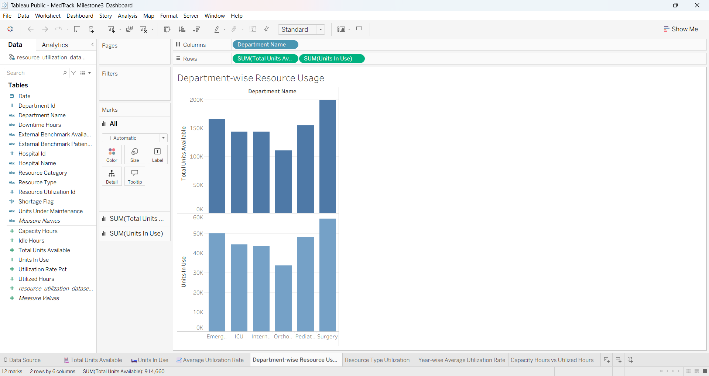
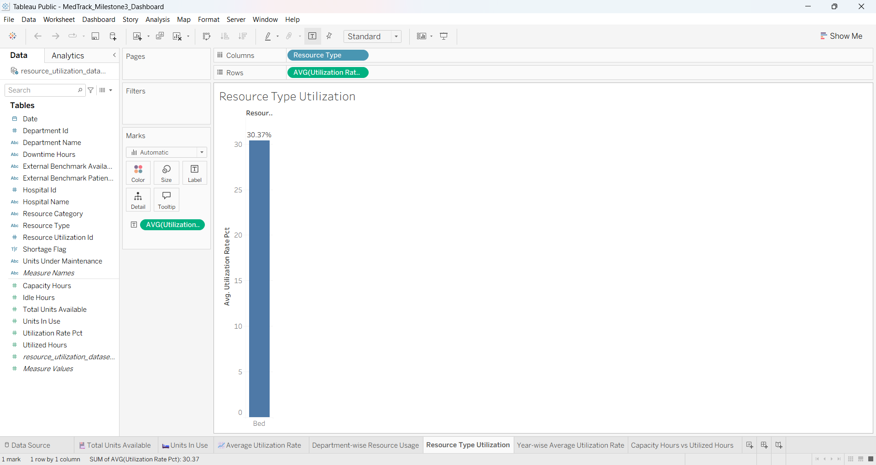
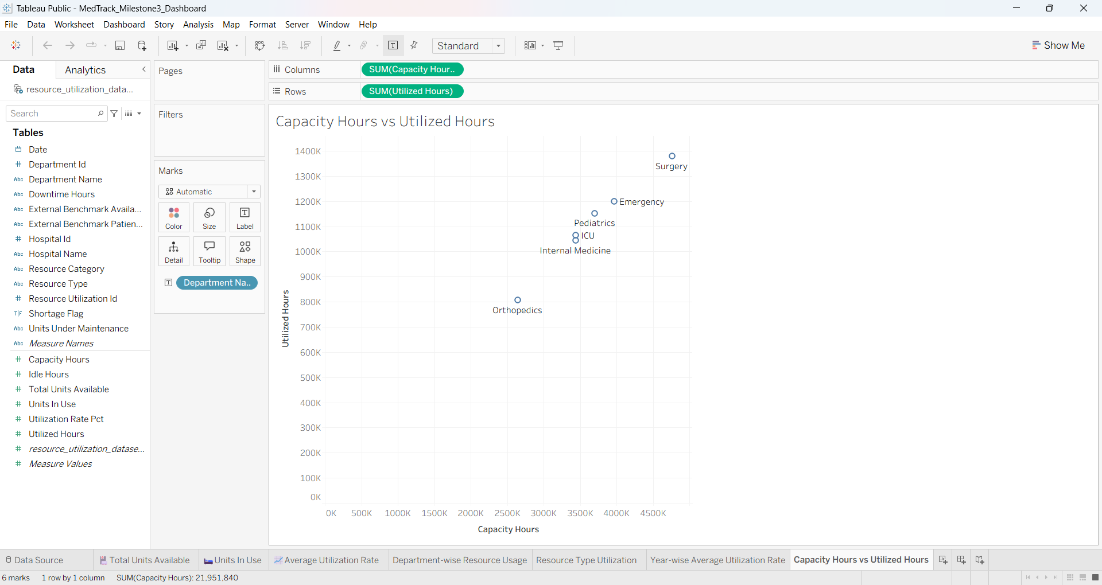
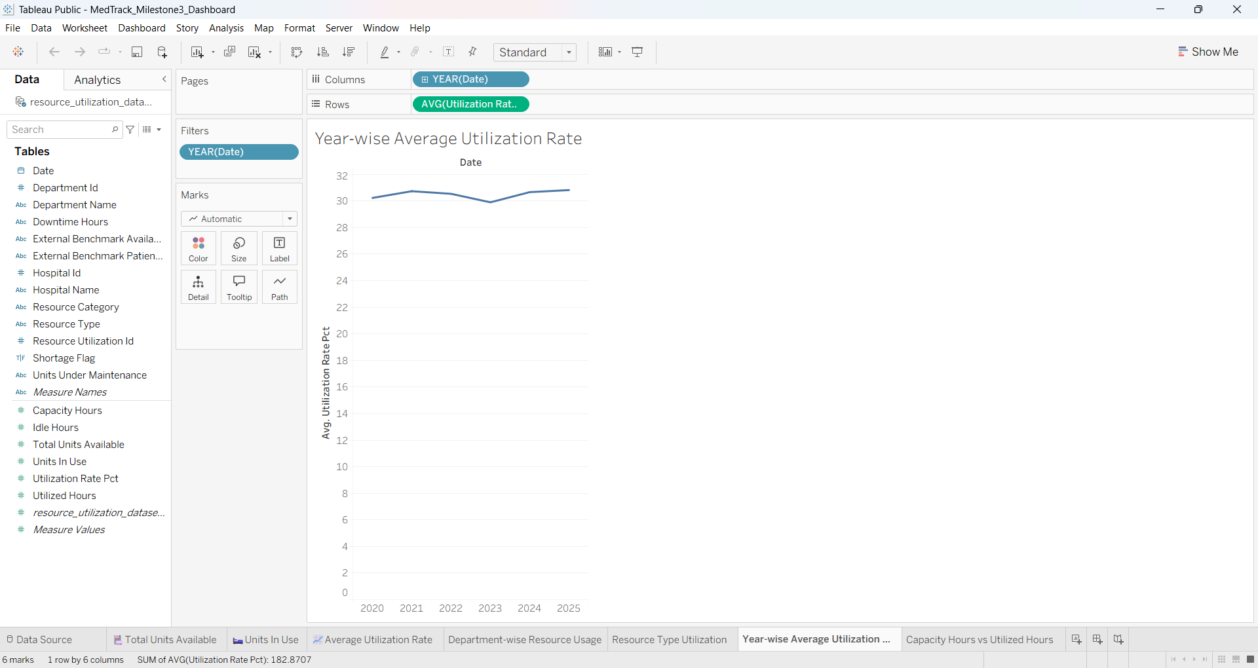
7. Tableau Dashboard — Resource Utilization

Slide 9
8. Data Testing and Reports
Milestone 4 deliverables
Python test script
Testing summary
Missing details
member5_data_testing.py
Runs the configured dataset checks.
member5_testing_summary.csv
Summarizes test results.
member5_missing_details.csv
Lists missing-value details.
Purpose of testing
• Make data-quality checks repeatable.
• Document findings in shareable CSV reports.
• Improve transparency before dashboard reporting.
MedTrack | Healthcare Data Analytics Project
9

Slide 10
Tableau Public — Dashboard Reference Links
Team dashboard links referenced from the group presentation
Hospital Overview Dashboard
https://public.tableau.com/app/profile/suhitha.paidi/viz/Hospital_Overview_Dashboard3/HospitalOverview?publish=yes
Department Analytics Dashboard
https://public.tableau.com/app/profile/suhitha.paidi/viz/Departmentdashboard_17913770908060/CmpAdmissionsvsDischarges?publish=yes
Resource Utilization Dashboard
https://public.tableau.com/app/profile/gandipalli.kavya/viz/MedTrack_Milestone3_Dashboard/Department-wiseResourceUsage
.
Patient Flow Dashboard
Patient flow dashboard MILESTONE 3 new | Tableau Public

Slide 11
Team Members
Suhitha
Shika
Divya Sree
Kavya
Jayanth Kumar
Devansh
Shivam Rawat

Slide 12
9. Limitations and Next Steps
Responsible interpretation
Limitations
Next steps
The analysis is descriptive. Dataset patterns alone do not establish clinical causes or predict individual outcomes.
Validate KPI formulas, refresh data when available, and review definitions with project mentors.
Future Scope
Real-Time Data Integration: Connect the dashboards to live hospital data for continuous monitoring.
Predictive Analytics: Use machine learning to predict patient readmissions and future hospital resource requirements.
Advanced Resource Management: Improve bed allocation and resource utilization through data-driven insights
MedTrack | Healthcare Data Analytics Project
10

Slide 13
Conclusion
MedTrack combines data-quality checks, readmission profiling, hospital resource KPIs, and Tableau visualization in one analytics workflow.
Thank you
Questions & Discussion
MedTrack | Final Project Presentation

